Slide 1
Buffer Overflow Attack

Slide 2
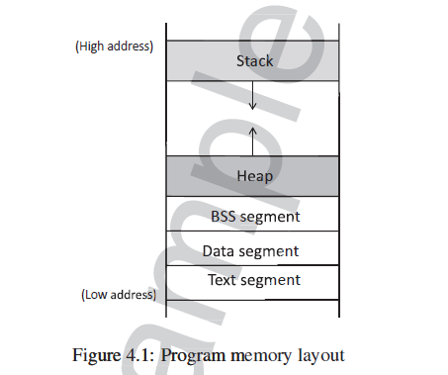
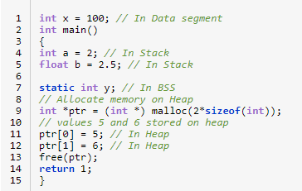
Introduction to Memory Layout

Slide 3
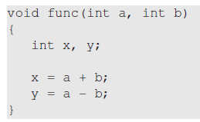
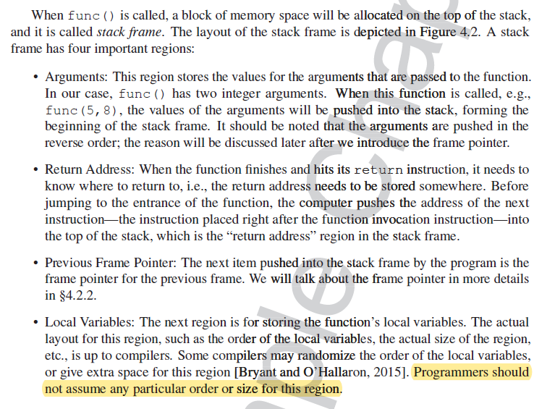
Stack Layout

Slide 4
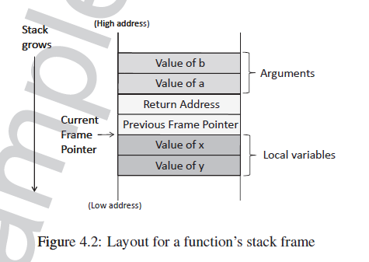
Stack Layout

Slide 5

Stack Layout
x = a + b
a and b are pushed in the reverse order, as stack
grows from high addr to low addr

Slide 6
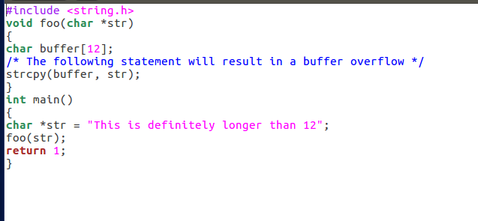

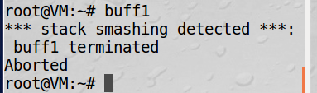
Buffer Overflow

Slide 7
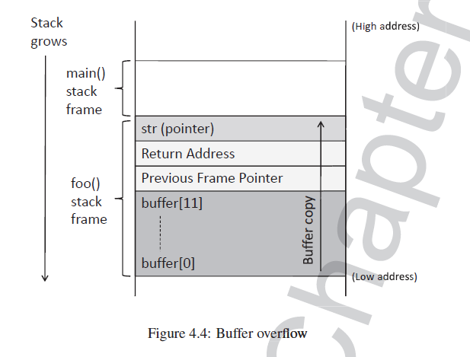
Buffer Overflow

Slide 8
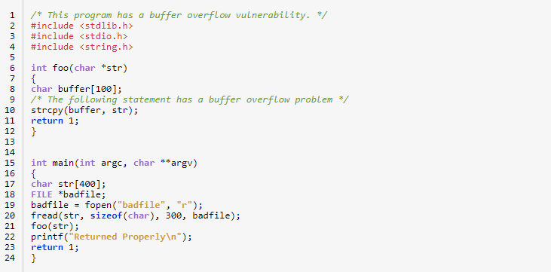
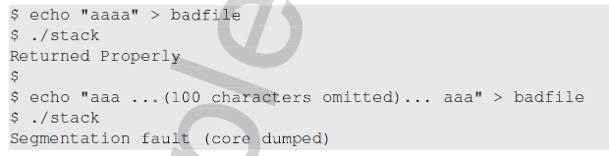
Vulnerable Program
stack.c

Slide 9
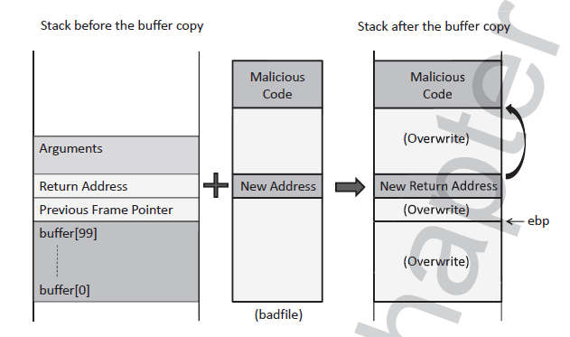
Objective

Slide 10
Disable Counter-measures
Disable Address Randomization
sudo sysctl -w kernel.randomize_va_space=0
Enable Stack Execution
gcc -o stack -z execstack -fno-stack-protector stack.c
Set UID
sudo chown root stack
sudo chmod 4755 stack

Slide 11
Steps towards Buffer Overflow Attack
Finding the Address of the Injected Code
we do not know the buffer’s memory address, because its exact location depends on the program’s stack usage.
In theory, the entire search space for a random guess is 2^32 addresses (for 32 bit machine), but in practice, the space is much smaller.
Most operating systems place the stack (each process has one) at a fixed starting address
Most programs do not have a deep stack.

Slide 12
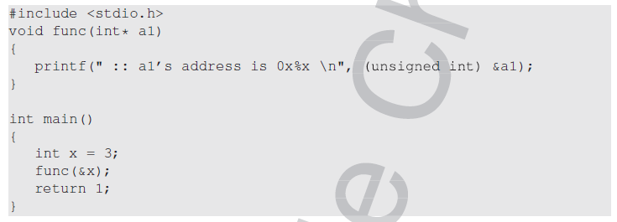
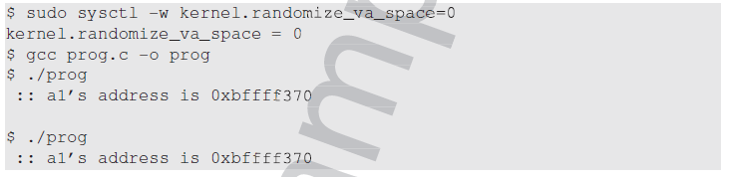
Steps towards Buffer Overflow Attack

Slide 13
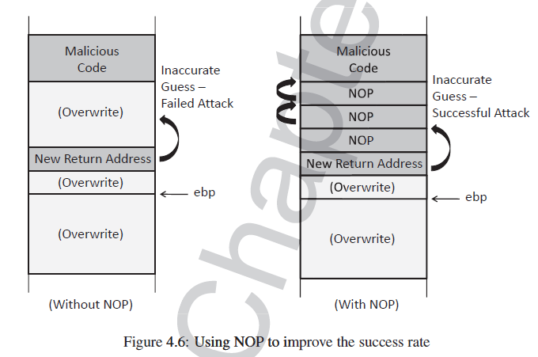
Steps towards Buffer Overflow Attack
2. Improving Chances of Guessing

Slide 14
Steps towards Buffer Overflow Attack
3. Finding the Address Without Guessing
In the Set-UID case, since attackers are on the same machine, they can get a copy of the victim program
gcc -z execstack -fno-stack-protector -g -o stack_dbg
stack.c

Slide 15
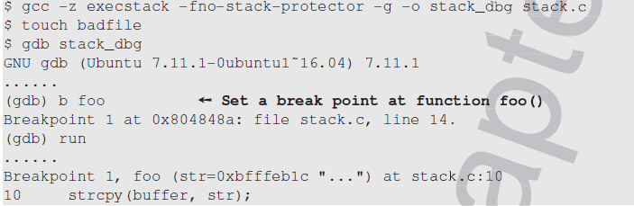
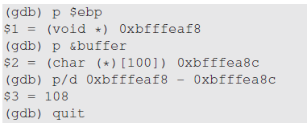
Steps towards Buffer Overflow Attack

Slide 16
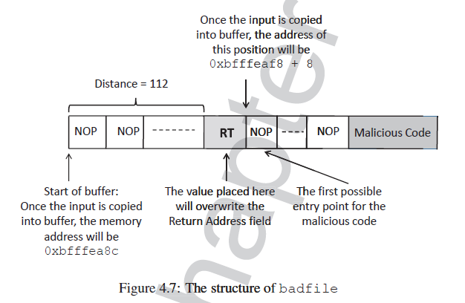
Steps towards Buffer Overflow Attack
4. Constructing the Input File

Slide 17
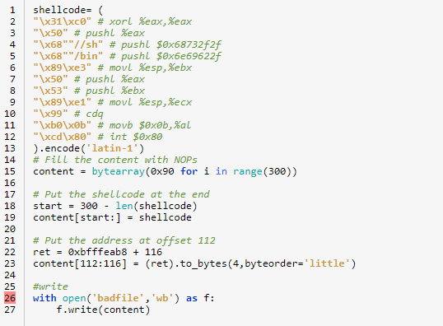
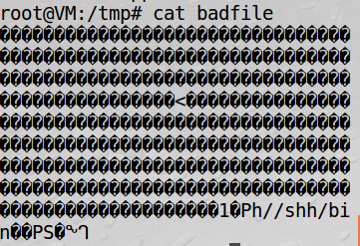
Steps towards Buffer Overflow Attack
exploit.py

Slide 18
Steps towards Buffer Overflow Attack
Input File
GDB may push some data into the stack causing the stack frame to be allocated deeper than it would be when the program runs directly. So the address maybe higher.
The input file cannot contain 0 in any of its byte!

Slide 19
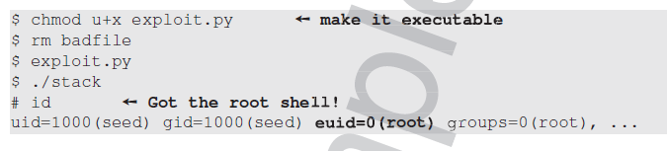
Steps towards Buffer Overflow Attack
Change default shell
sudo ln -sf /bin/zsh /bin/sh
Execute python program to generate the badfile

Slide 20
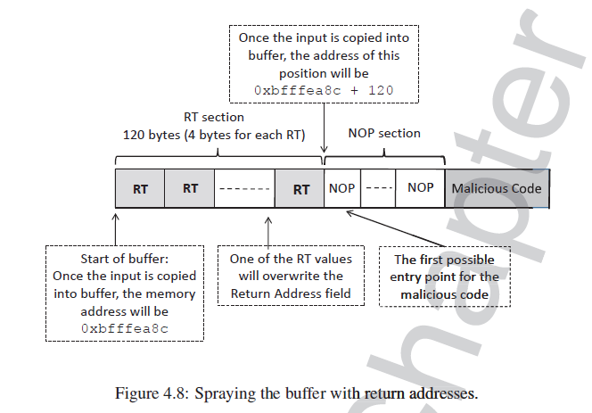
Attacks with Unknown Address and Buffer Size
Knowing the Range of Buffer Size

Slide 21
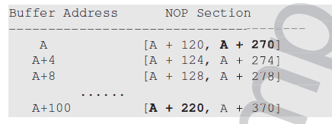
Attacks with Unknown Address and Buffer Size
Range of Buffer Address

Slide 22
Attacks with Unknown Address and Buffer Size
General Solution
the first S bytes of the buffer are used for the spraying purpose (the RT section), and the next L bytes of the buffer are filled with the NOP instruction
Assume that the buffer address is within the range of [A, A + H]
As long as H is less than L, we can find a solution. If the range is too wide, we break it into smaller subranges, and then construct a malicious payload for each of the subranges.

Slide 23
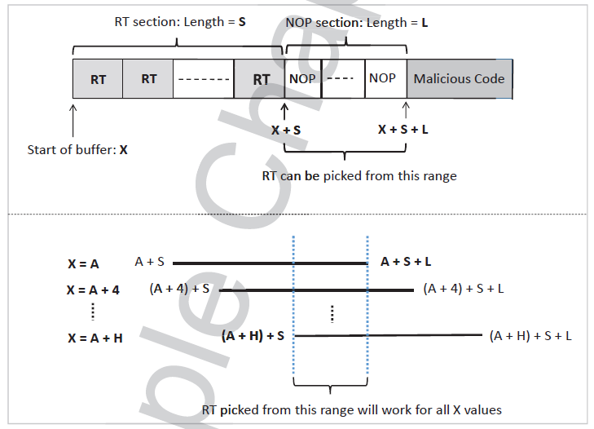
Attacks with Unknown Address and Buffer Size

Slide 24
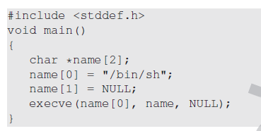
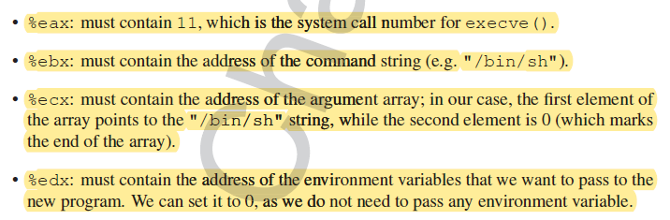
Writing Malicious Code
Assembly Code

Slide 25
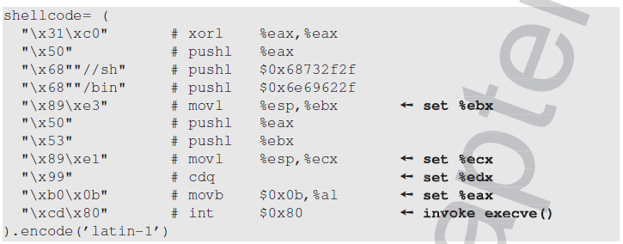
Writing Malicious Code
Assembly Code

Slide 26
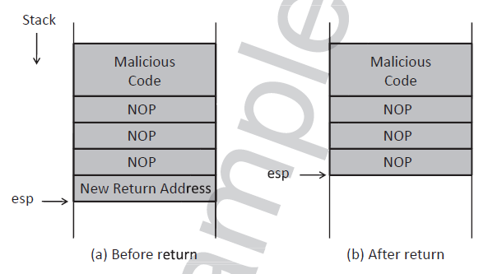
Writing Malicious Code
The positions of the stack pointer before and after function returns

Slide 27
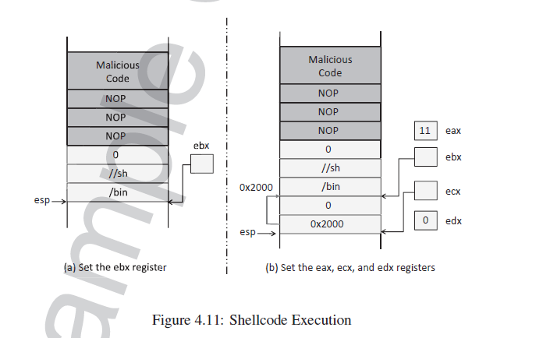
Writing Malicious Code

Slide 28
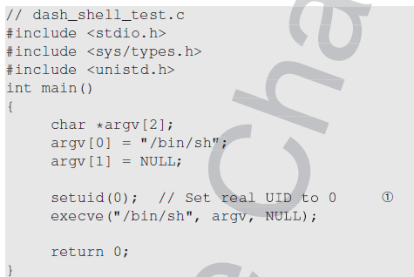
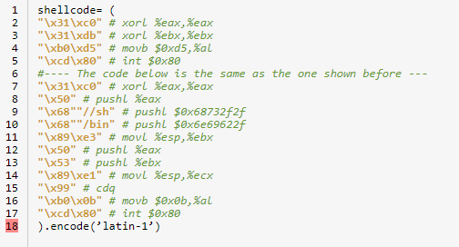
Writing Malicious Code
Set UID

